Slide 1


BORCELLE
Home
Photo
About Us
Contact
CSL2090 PCS2
COURSE PROJECT
SHAREKARO
A DATA SHARING PLATFORM

Slide 2

BORCELLE
Home
Photo
About Us
Contact
OVERVIEW
The project entails developing a software solution for local WiFi networks, facilitating secure messaging, seamless file transfers, and network traffic monitoring. Users can exchange messages, share files, and oversee network activity conveniently through a user-friendly interface. Emphasis will be placed on robust security measures, including encryption for data transmission and access controls. The software will be designed for scalability and optimal performance to accommodate varying user demands and network loads, ensuring efficient communication and management within the local WiFi ecosystem.

Slide 3

BORCELLE
Home
Photo
About Us
Contact
PEER TO PEER MESSSAGING
Functionality: Real-time 2-way messaging using UDP sockets. Key Features:
UDP-based communication: Utilizes UDP (User Datagram Protocol) for lightweight and efficient messaging over the network.
Threading for concurrent operations: Implements threading to enable simultaneous sending and receiving of messages, ensuring smooth and uninterrupted communication.
Simple "quit" command for disconnection: Provides a straightforward command for users to gracefully disconnect from the messaging system, enhancing user experience and usability.

Slide 4
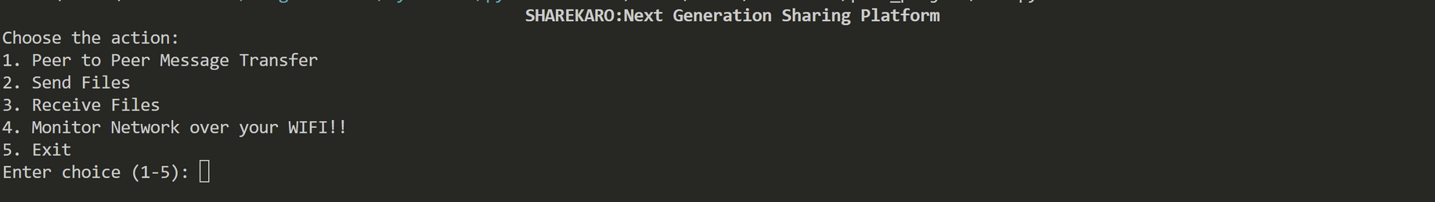
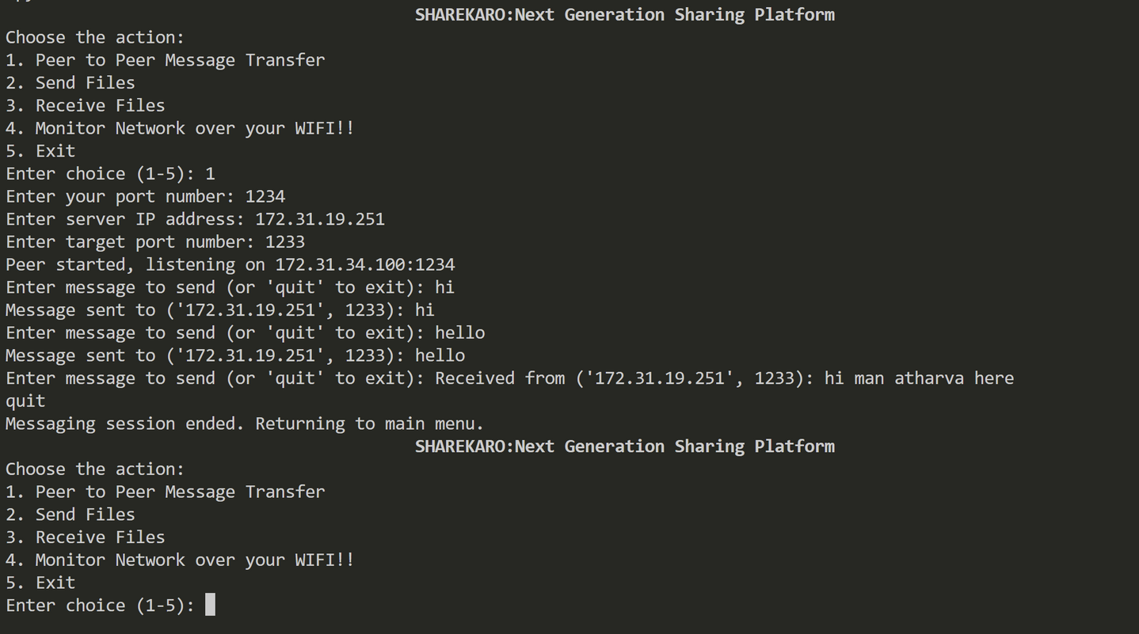
REAL APPLICATIONS PICS
Home
Photo
About Us
Contact
Entry Page
Normal exchange of text message sbetween peers

Slide 5

BORCELLE
Home
Photo
About Us
Contact
PEER TO PEER MESSSAGING
Functionality: Real-time 2-way messaging using UDP sockets. Key Features:
UDP-based communication: Utilizes UDP (User Datagram Protocol) for lightweight and efficient messaging over the network.
Threading for concurrent operations: Implements threading to enable simultaneous sending and receiving of messages, ensuring smooth and uninterrupted communication.
Simple "quit" command for disconnection: Provides a straightforward command for users to gracefully disconnect from the messaging system, enhancing user experience and usability.

Slide 6
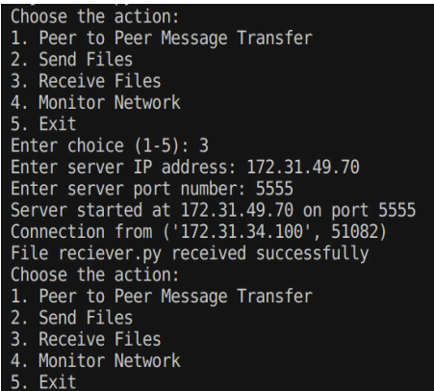
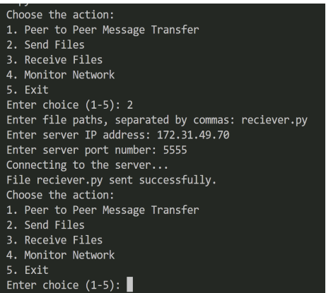
Home
Photo
About Us
Contact
REAL APPLICATIONS PICS
Recieving Side Output
Sending Side Output

Slide 7

BORCELLE
Home
Photo
About Us
Contact
NETWORK TRAFFIC ANALYSIS
Functionality:
get_wifi_interface: Locates the Wi-Fi interface.
get_wifi_stats: Retrieves network statistics for the Wi-Fi interface.
print_wifi_stats: Displays the statistics on the console, highlighting anomalies if detected.
write_to_csv: Records the statistics in "Network.csv", updating every 5 seconds to provide real-time data.
detect_anomaly: Compares current and previous statistics to identify anomalies, displaying them in black font for visibility.
monitor_network: Main function running an infinite loop to continuously monitor the network and print statistics.
Key Features:
Real-time monitoring of Wi-Fi interface statistics allows immediate insights into network performance.
Anomaly detection based on significant changes in the rate of bytes sent and received, ensuring prompt identification of irregularities.
CSV logging of network statistics enables detailed analysis and real-time updates of the CSV file, enhancing user understanding.
Self-settable threshold for anomaly detection in bytes provides flexibility for customized monitoring based on user preferences.

Slide 8
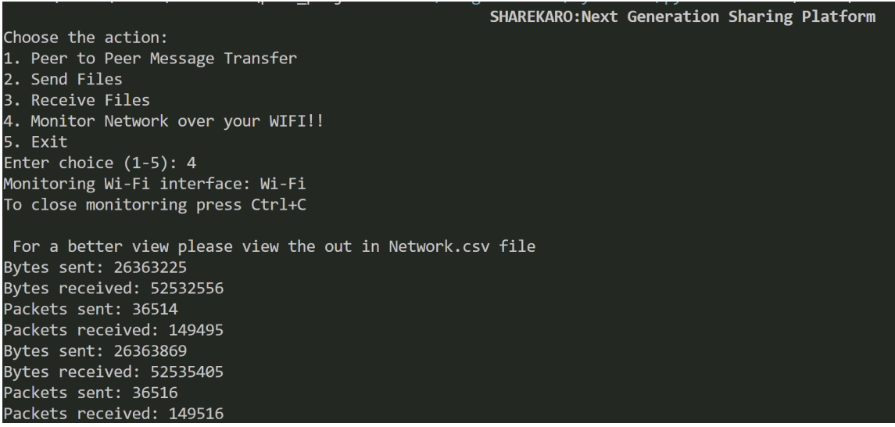
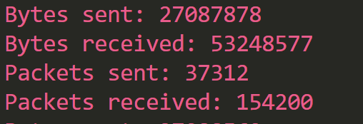
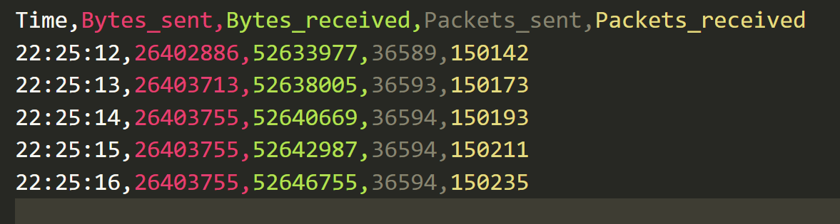
Home
Photo
About Us
Contact
REAL APPLICATIONS PICS
Anomaly situation highligted in red
Normal View of Output screen after Selecting Network traffic
Better analysis view of traffic through network.csv file

Slide 9


BORCELLE
Home
Photo
About Us
Contact
TEAM MEMBERS
Saumitra Agrawal(B22AI054)
Atharva Date(B22AI045)

Slide 10
BORCELLE
Home
Photo
About Us
Contact
WWW.REALLYGREATSITE.COM
THANK YOU

